Slide 1
Dignity for All Students Act
Kenmore-Town of Tonawanda UFSD

Slide 2
Dignity Act
States that NO student shall be subjected to harassment or discrimination
by employees or students on school property, at a school function and that may occur outside school property based on their actual or perceived:
Race
Color
Weight
National Origin
Ethnic Group
Religion
Religious Practice
Disability
Sexual Orientation
Gender
Sex

Slide 3
Bullying ~ Cyber Bullying ~ Intimidation Verbal Threats ~ Harassing Conduct Abuse ~ Inappropriate Touching
This can done through communicating by any means including:
Oral
Written
Electronic Devices
On or off school property, where the content of such communication can reasonably be interpreted as a threat to commit an act of violence on school property; or results in material or substantial disruption to the educational environment.

Slide 4
DASA Goal
The goal of the Dignity Act is to create a safe and supportive school climate where students can learn and focus, rather than fear being discriminated against and/or verbally and/or physically harassed.

Slide 5
What is Bullying?
Acts of aggression intended to cause harm
(verbal, physical, relational or cyber)
By a peer/group of peers or adult operating from a
position of strength or power
Usually repeated, or has the potential to be
repeated, over time

Slide 6
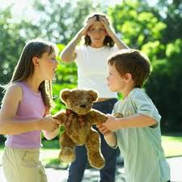
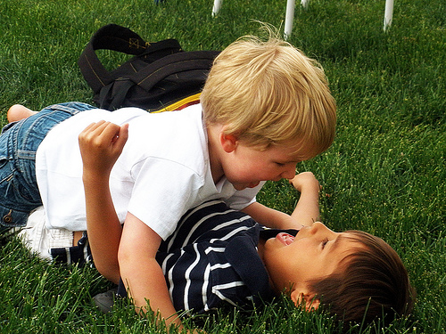
How is Bullying Different from Conflict or Play?
Conflict: A struggle, dispute or misunderstanding between two equal forces
Playing: A mutually desirable interaction (positive affect, give-and-take) rough, tumble and playing that many often mistake for aggression and bullying

Slide 7
Students Most Likely to Be Bullied
Some research suggests that students are most likely to be bullied because of perceived differences, such as:
Appearance or body size
Perceived to be gay, lesbian, bisexual or transgender
Degree of masculinity or femininity
Performance in school
Race, ethnicity, national origin and /or religion
Low-income household
Youth with disabilities and other special health needs

Slide 8
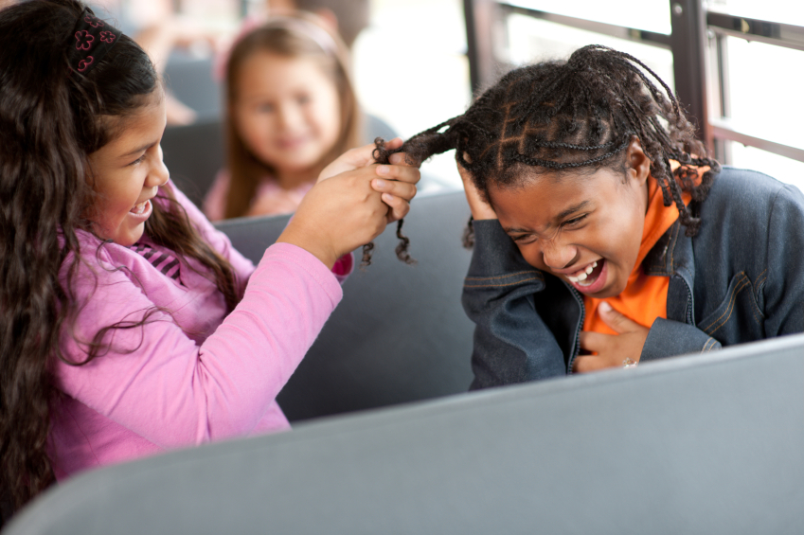
Common Myths About Students Who Bully
Students who bully are loners
Students who bully have low self-esteem and are insecure
Students bully others because they want attention
Bullying behavior is a normal part of children being children
Only boys bully others

Slide 9
Possible Indicators of Students Who Are Being Bullied
Physical signs like torn, damaged or soiled clothing; unexplained cuts, bruises and scratches; missing or damaged personal items like books or homework with out a credible explanation
Socially isolated
Become truant or have frequent claims of physical ailments in order to be allowed to go home
Begin doing poorly in school, receiving declining grades

Slide 10
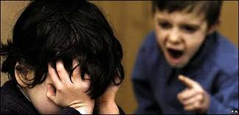
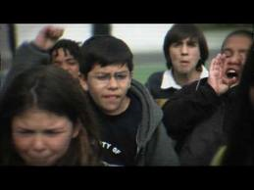
Harassment
Generally defined as conduct which annoys, threatens, intimidates, alarms or puts a person in fear of safety
Unwanted, unwelcomed and uninvited behavior that demeans, threatens or offends the victim and results in a hostile environment

Slide 11
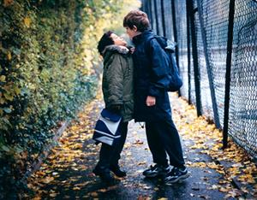
Types of Bullying & Harassment
Physical Bullying
~ Punching, shoving, acts that hurt people
Verbal Bullying
~ Name calling, making offensive remarks
Indirect Bullying (similar to relational aggression)
~ Spreading rumors, excluding, ganging up
Cyber Bullying
~ Sending insulting messages or threats by e-mail, text messaging or
social networking
Harassment
~ Can be verbal, nonverbal, physical or electronic aggression,
intimidation or hostility

Slide 12
Who is involved in Bullying
Prevention in our Schools?
Students
School Board/
Administration
Teachers
Support Staff
School Nurses
School Counselors/School Psychologist/
Social Workers
Parents
Community

Slide 13
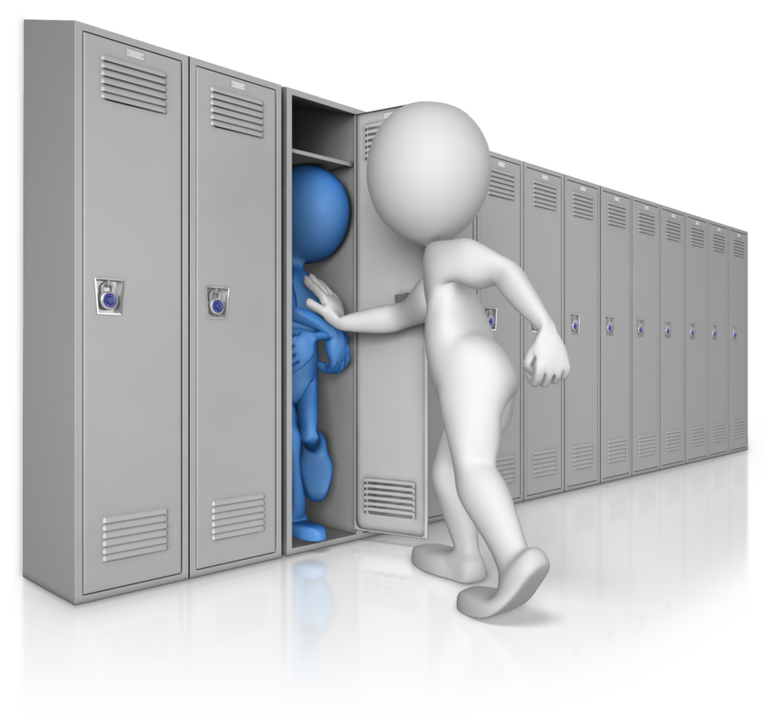
Increase Awareness & Supervision
Be Present and Positive
Greet students by name
Be models of dignity and respect
Acknowledge and Reward Desired Behavior
Arrange for Active Supervision in “Hot Spots” (hallway, lunch, recess, before school)

Slide 14
Staff Responsibilities
If you see an incident or a student comes to you to discuss an incident related to bullying or harassment by an employee or student it is your responsibility to do the following:
Gather facts from the alleged victim
Touch base with the Dignity Act Coordinator and Administration
Discuss the incident with the DAC to provide support for reporting the DASA incident
Document the incident utilizing the district report form (new regulated mandate)

Slide 15
Administrative Responsibilities
Investigations may involve selected school personnel based on their knowledge and experience of investigative techniques:
Use a continuum of consequences and interventions
Written apology if sincere, education/counseling, loss of privilege, detention, lunch detention, in-school suspensions, out of school suspension, increased supervision, parent contact, coordination with law enforcement or mental health service
Report the incident to the alleged victim’s parents and the offender(s) parents
Keep the parents informed, get them involved and keep them aware of future incidents
Follow-up privately with the alleged victim to provide support and assess needs – document the follow-up on the report form
Once the report form is completed hand it in to the DAC to sign-off on the report and for tracking purposes

Slide 16
Involve Parents as Partners
Work with parents proactively
Communicating about an incident
Be timely with communication
Focus on the behavior (not the person)
Avoid blaming or judging (expect denial)
Emphasize how this type of behavior can be a problem for their child, the other person and the school environment
Inform the parent about school response
Work together to help the child behave in other ways
Provide outside resources – Family Support Center

Slide 17
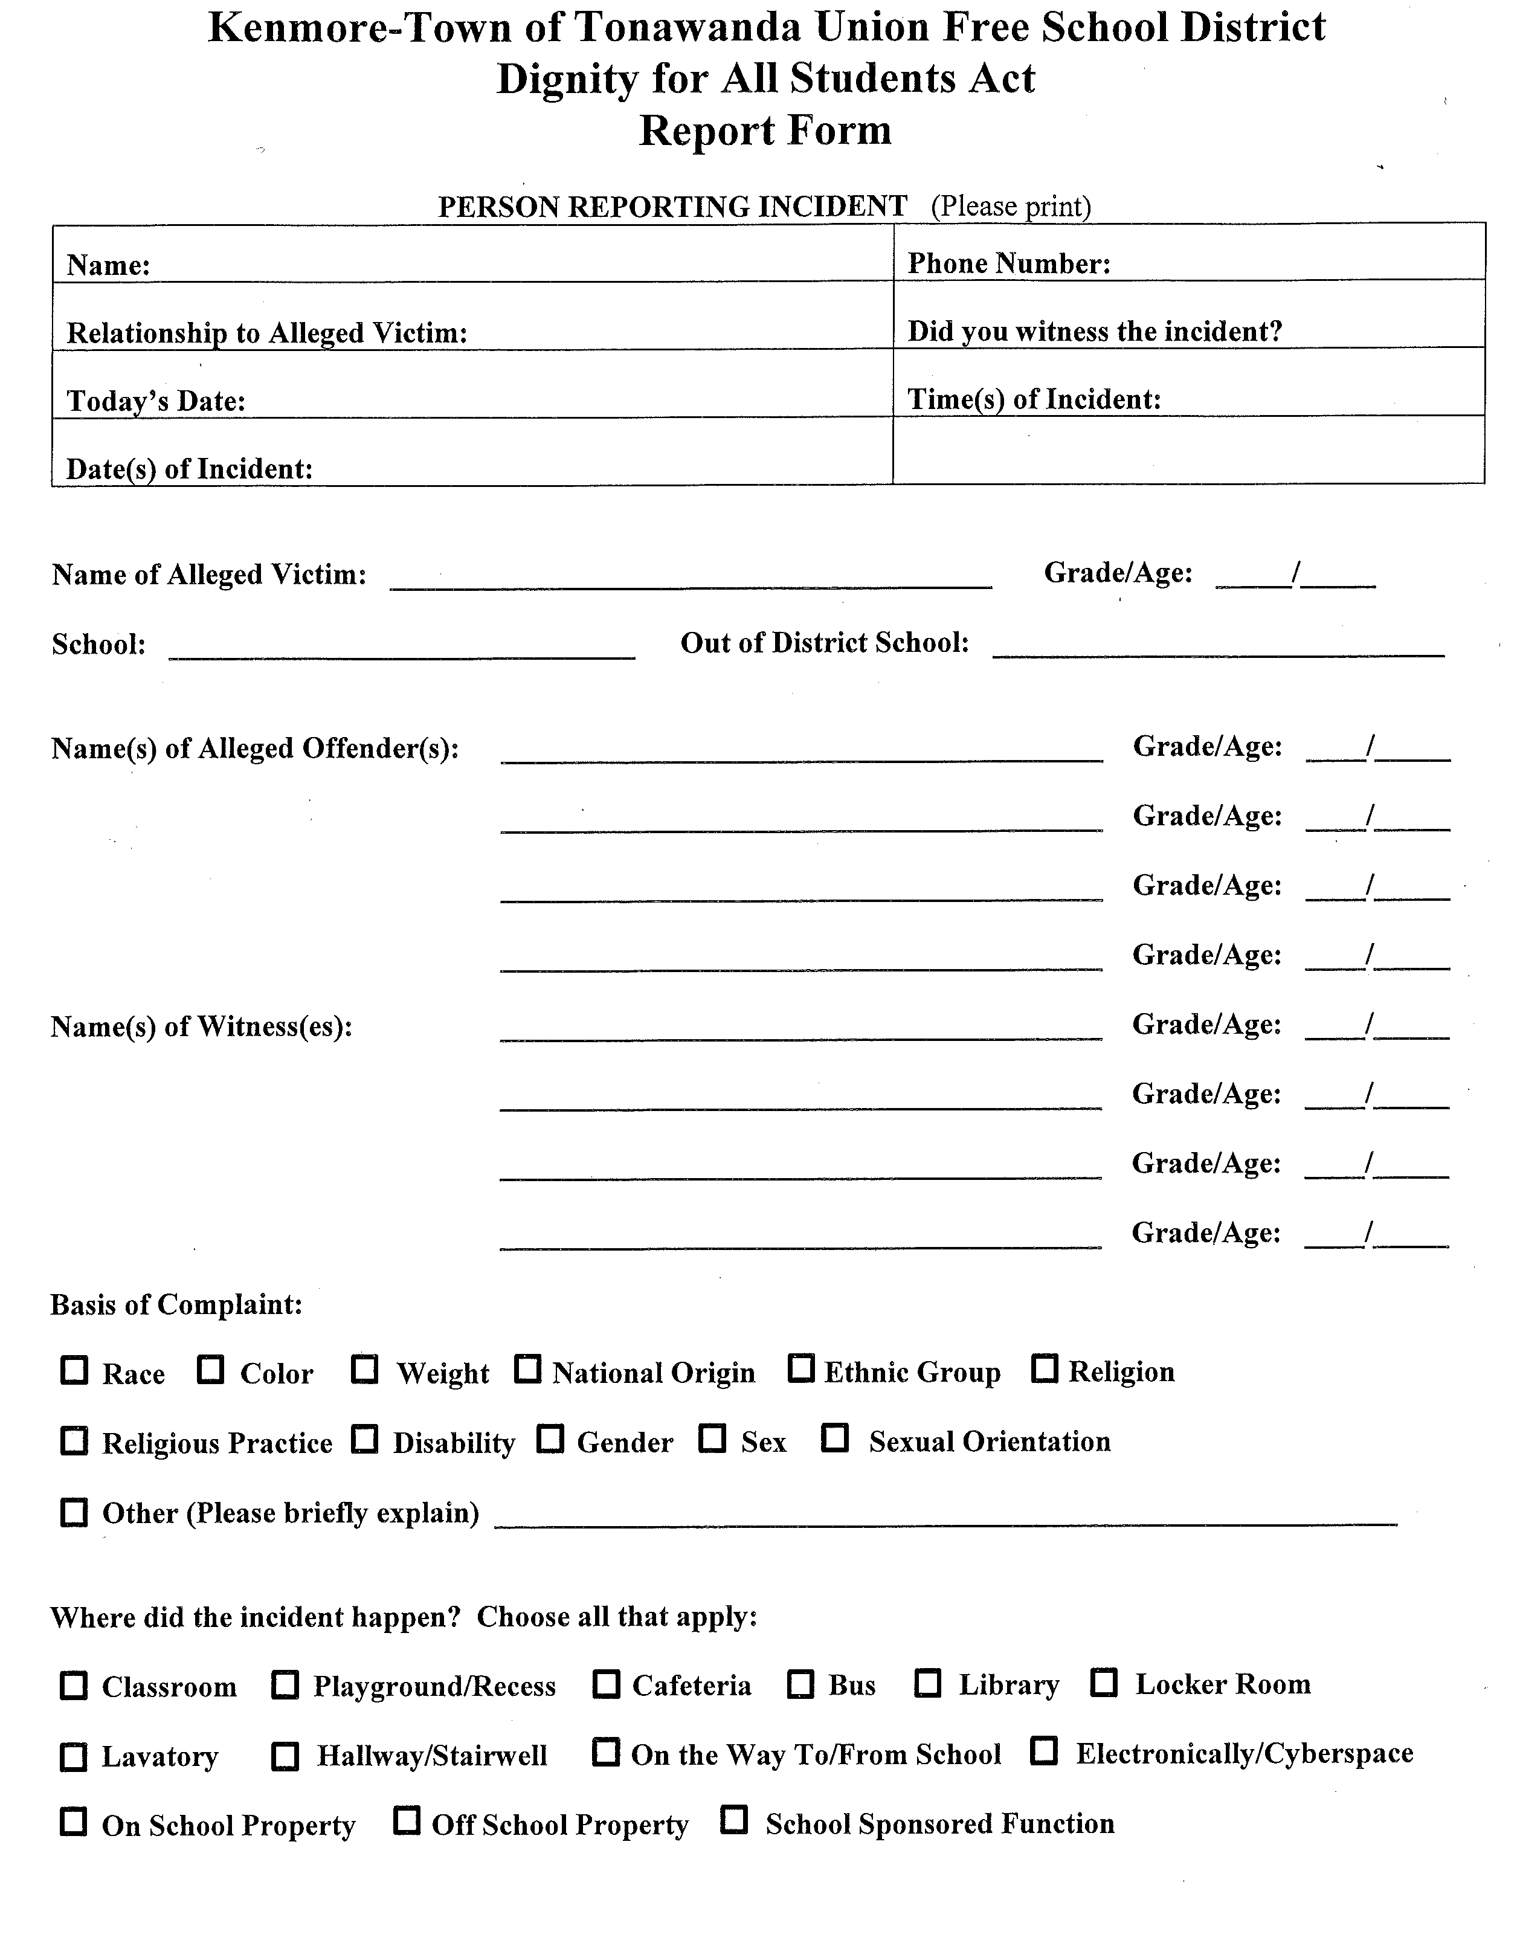

Slide 18
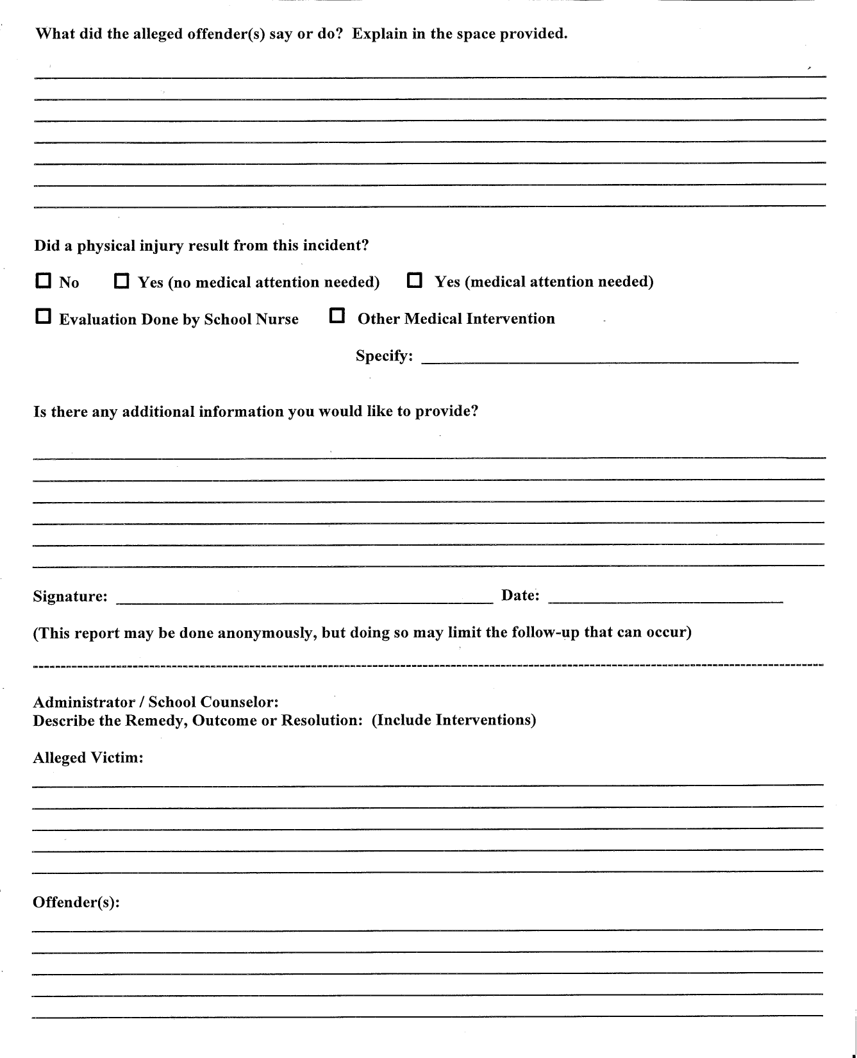

Slide 19
When in Doubt
Contact Your DAC!

